Slide 1
OVERVIEW
Home
Setup & Maintenance
Configuration & Reports
Customization
Tax Calculation & Location
Mapping Tools
Company
Batch Test
Access Tools
Reporting Tools
Employee Groups
What-If -Test
Database Tools
Address Override
Maintenance Tools
Pension What if Test
Configuration
Tax Effective Date Override
Custom Payments
Tax Locator
Custom Garnishments
Message Viewer
Garnishment Groups
Custom Tax Codes

Slide 2
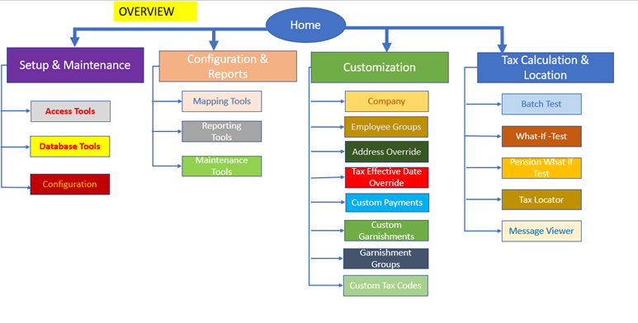
Home
Set Up & Maintenance
Database Tools
Access Tools
Configuration
Custom Backup/Restore-
Datasets
General Config On/Off
Custom Backup/Restore status-
Favorite Links
Optional/Unemployment Rate Override Backup
Logins & Permissions
Optional/Unemployment Rate Override Backup status
No. of Datasets defined
No. of log ins defined
Database Load
Database Load Status
Audit log viewer
Install Machine key
Please Note: The links within the dotted
boxes do not display for TF SaaS

Slide 3
Home
Configuration & Reports
Maintenance Tools
Reporting Tools
Mapping Tools
Regulatory Bulletin level
Quick Formulas
Tax Codes
Tax Locator Level
Tax Details
Tax Types
Cyclic Level
User Data
Payment Codes
Manual update
Manual Update Status
Please Note: The links within the dotted
boxes do not display for TF SaaS

Slide 4
Home
Tax Effective Date Override
Address Override
Customization
Company
Employee Groups
Custom Garnishments
Custom Tax Codes
Garnishment Groups
Custom Payments
Worksites
Custom Payment Exceptions
Custom Formula
Disposable Override
Payment Override
Optional Rate Overrides
Custom Tax Payment Override
Garnishment Formula Override
Group Override
Unemployment Overrides
Custom Garnishment Formula
Reciprocal Override
Custom nexus Data

Slide 5

Usage across and within Customization & Configuration
Home
Cross Section usage
Customization
Configuration & Reports
Custom Garnishments
Custom Payments
Mapping Tools
Company
Employee Groups
Custom Tax Codes
Garnishment Groups
Disposable Override
Payment Codes
Worksites
Paument Override
Custom Formula
Tax Types
Custom Tax Payment Override
Garnishment Formula Override
Custom Payment Exceptions
Optional Rate Overrides
Tax Codes
Group Override
Unemployment Overrides
Custom Garnishment Formula
Custom nexus Data

Slide 6
Recent Usage Bold lines Related Activities in dotted lines
Home
Customization
Configuration & Reports
Custom Garnishments
Custom Payments
Mapping Tools
Company
Employee Groups
Custom Tax Codes
Garnishment Groups
Disposable Override
Payment Codes
Worksites
Custom Formula
Payment Override
Custom Payment Exceptions
Garnishment Formula Override
Tax Types
Custom Tax Payment Override
Optional Rate Overrides
Tax Codes
Unemployment Overrides
Group Override
Custom Garnishment Formula
Custom nexus Data

Slide 7
Related Activities across and within Customization & Configuration
Home
Customization
Configuration & Reports
Custom Garnishments
Custom Payments
Mapping Tools
Company
Employee Groups
Custom Tax Codes
Garnishment Groups
Disposable Override
Payment Codes
Worksites
Payment Override
Custom Formula
Custom Payment Exceptions
Tax Types
Custom Tax Payment Override
Garnishment Formula Override
Optional Rate Overrides
Group Override
Tax Codes
Unemployment Overrides
Custom Garnishment Formula
Custom nexus Data

Slide 8
Usage & Related Activities across and within TF and What if Test
Home
What if Test
Tax Calculation & Location
Employee Groups
Group Override
Company
Batch Test
What-If -Test
Custom Payments
Custom Payment Exceptions
Custom Tax Codes
Custom Garnishment Formulas
Custom Garnishments
Custom Tax Payment Overrides
Company Unemployment Overrides
Mapping Tools Tax Types
Tax Codes
Tax Locator
Garnishment Groups
Message Viewer

Slide 9
Usage & Related Activities across and within TF and Pension What if Test
Home
Pension What if Test
Tax Calculation & Location
Employee Groups
Group Override
Company
Batch Test
Pension What-If -Test
Custom Payments
Custom Payment Exceptions
Custom Tax Codes
Custom Garnishment Formulas
Custom Garnishments
Custom Tax Payment Overrides
Company Unemployment Overrides
Tax Locator
Mapping Tools Tax Types
Tax Codes
Garnishment Groups
Message Viewer

